Slide 1

Airport Optimization
By:
Devin Latz, Andres Londono, Benjamin Tutka
Date: May 2, 2024

Slide 2
Our Business Objective
Goal: Identify the best locations for our first four operational sites across 11 states.
Purpose: Strategically expand our presence to enhance accessibility and operational efficiency in the Southeastern markets.

Slide 3

The 11 States We chose
Alabama, Arkansas, Florida, Georgia, Louisiana, Mississippi, North Carolina, Oklahoma, South Carolina, Tennessee, Texas

Slide 4
Choosing Our First Hub / Testing the Model
Arkansas is chosen as the primary hub for our operational network, reflecting our roots in the state and also since we are students at the University of Arkansas. This hub is set to become the cornerstone from which we will expand into multiple states.
Analytical Approach: To determine the best airport location within Arkansas for our central hub, we applied a weighted p-median model. This enhanced model carefully considered geographic centrality and population distribution to identify the most suitable site.

Slide 5
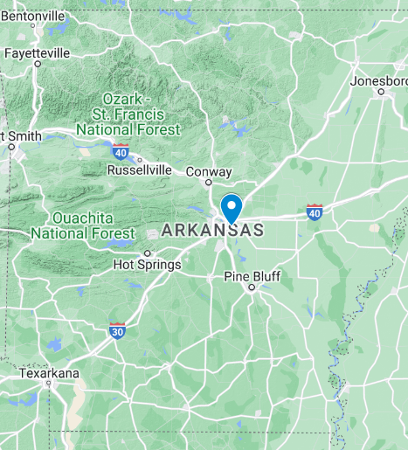
Model Results for Arkansas
The weighted p-median model has determined that the optimal site for our operational hub is the Bill & Hillary Clinton Airport in Little Rock.

Slide 6
Expanding Beyond Arkansas: Our Next Optimal Hub Locations
Having established Arkansas as our central hub, we deployed our optimization model across Arkansas and the remaining 10 states chosen for potential expansion. The analysis identified the most advantageous locations for our three new hubs, setting the stage for strategic growth and enhancing our network across these states.

Slide 7
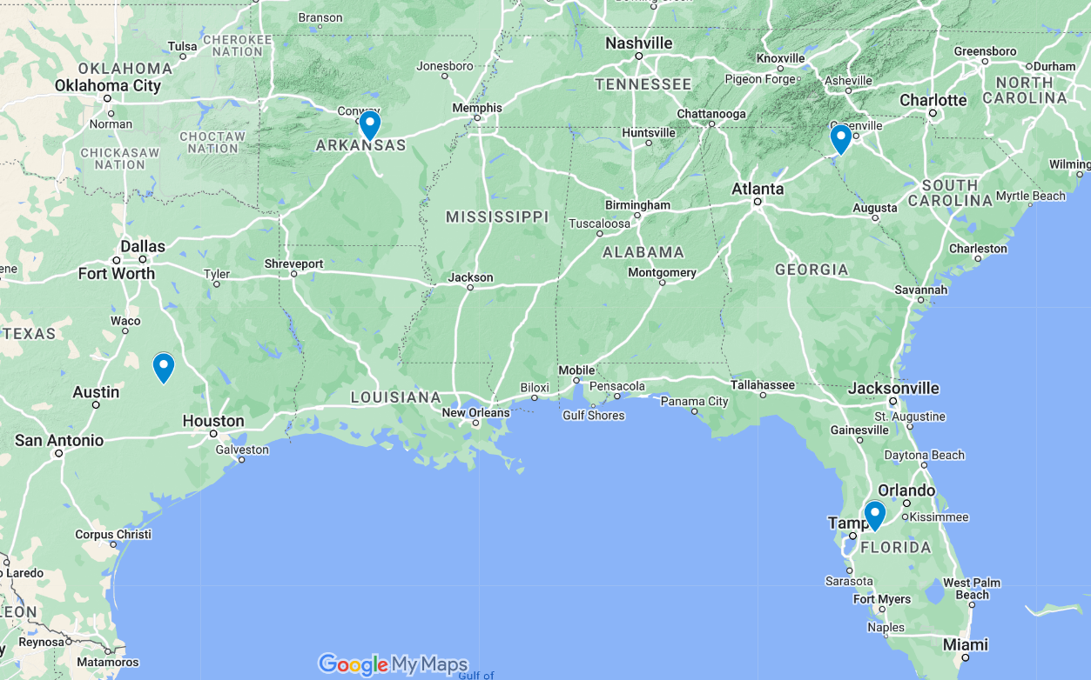
Results of the Model
The model has identified the most optimal locations for our three new hubs across the 11 states:
Easterwood Airport, College Station, TX
Anderson Regional Airport, Anderson, SC
Lakeland Linder International Airport, Lakeland, FL
Average person is only 165 miles from an airport.

Slide 8
The Model Indexes I – Counties, J – Airports Decision Variables X_{ij} – 1 if county i is assigned to airport j, 0 otherwise. Y_{j} – 1 if airport j is selected as one of p optimal location, 0 otherwise.
Parameters
d_{ij} – the distance between county i and airport j.
a_{i} – the population in county i.
p – the number of airports to select.

Slide 9
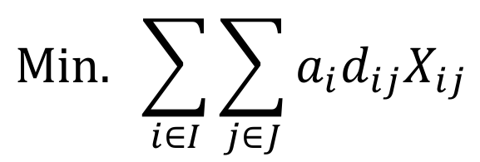
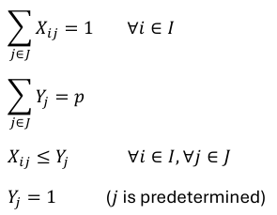
The Model Objective
Constraints
s.t.

Slide 10

The Data
Used two datasets:
Airport data
Geographic data (such as county population and location coordinates).
Used this data to put it into the parameter d_{ij} (distance) while parameter a_{i} (county population) was included in the data already.

Slide 11
Summary
Goal: Find which airport would be best suited for our hub location(s) by considering total distance using the factors of a county’s population and the airport that they’re assigned to.
How: By minimizing the product of these parameters to ultimately give us our objective function:
Airport (j) is assigned to county (i) giving us (X = 1)
Take county (i)'s populations and multiply by the distance from county (i) to airport (j)
The optimal solution is the convenience of a county's population to get to that county's airport.
Applied: In Arkansas, Bill & Hillary Clinton Airport would be best fit for our hub given the convenience (optimal solution). Given the model's success we furthermore looked over 11 states total and changed our parameter (p) to equal 3 to get three optimal hub locations out of those states.

Slide 12
Takeaways
You can start with a small model and expand from there
Sometimes multiple models are necessary to find the desired answers
How adding weights to variables can change the outcome of a model

Slide 13
Citations Model IEEE Conference Publication | IEEE Xplore Data Counties - IPUMS NHIS Airports - Tyler Data & Insights (bts.gov)

